Slide 1
More Tools of Photoshop…

Slide 2
Working with Selection
In Menu Bar >>> Select …
Select All (Ctrl + A to select the whole canvas)
Deselect (Ctrl + D to deselect everything)
Reselect (Ctrl+ Shift + D to reselect previous selection)
Invert selection (Ctrl + Shift + I to select what was not selected)

Slide 3
Working with Selection
In Menu Bar, Select Modify:
  Border
  Smooth
  Expand
  Contract
  Feather

Slide 4
Painting Tools
The main painting tools in Adobe Photoshop are the Pencil and the Brush.
The Pencil draws free form lines with a hard edge, and the Brush - draws lines with a softer edge.
It is possible to draw distinct or fuzzy lines with the Brush, but they will always be a little soft, because its edges are indistinguishable from the background. Lines drawn with the Pencil always have a sharp edge, because there is no interaction with the background.

Slide 5
Brush Tool (B)
A brush uses brush presets that are predefined (or user defined). A brush preset is any brush tip with defined characteristics (such as size and shape).
Properties:
  Master Diameter
  Hardness
  Opacity
  Flow
  Mode: The blending mode. For most work Normal will be the best option. Experiment with other modes to see what they do.

Slide 6
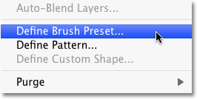
To make a Customize Brush
Create A New Brush From The Document
  To create a new Photoshop brush from the document, simply go up to the Edit menu at the top of the screen and choose Define Brush Preset from the list of options.
  Name the new brush.
  Click OK when you're done to close out of the dialog box, and that's all there is to it!

Slide 7
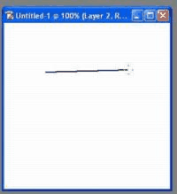
Pencil Tool (B)
Pencil consists of is a 1 pixel brush tool tip.
Properties:
  Master Diameter
  Hardness
  Mode
  Opacity
  Another technique for this tool is the shift+click method. First click a point, then shift click another location on the canvas - connecting the dots together as you go.

Slide 8

Color Replacement Tool (B)
Photoshop continuously samples the color that's directly under the target symbol in the center of the tool's cursor.
Choose a Tolerance value (1–100%) for the range of colors to be recolored. A high Tolerance value permits a wide range of colors to be recolored; a low value allows only pixels that closely match the sampled color to be recolored.

Slide 9
Three Main Sampling Techniques
Click a Sampling button:
  Continuous to apply the current Foreground color to all pixels the brush passes over.
  Once to sample the first pixel the brush crosshairs click on and apply the Foreground color only to pixels that match that initial sampled color (since this option confines the sampling to just one color, if you need to replace, say, different shades of a particular color, you would have to sample each one separately)
  Background Swatch to replace only colors that match or are similar to the current Background color.

Slide 10
Clone Stamp Tool (S)
The Clone stamp tool allows you to paint with a sample of an image.
The Clone Stamp tool is a non-interpretive tool, in that it simply samples pixels from a source location and copies them to a destination location.
The Clone Stamp tool should be used whenever you want maximum control or are working in areas of transition or varied texture where the Healing and Spot Healing brushes will fail.
Using Clone Source palette , you can take multiple samples.

Slide 11
Pattern Stamp Tool (S)
The Pattern Stamp tool is in the tool family with the Clone Stamp tool. The two tools paste something.
The difference is the source of the something-to-be-pasted.
When using the Clone Stamp tool—you take part of the photograph—and paste it on another part of the same photograph.
With the Pattern Stamp tool—you're pasting a pattern on to your photograph.

Slide 12
Operations Performed …
Apply a Pattern
Make a Pattern
  Edit : Define Pattern

Slide 13
Restore part of an image to its previously saved version
Do one of the following:
  Use the History Brush tool to paint with the selected state or snapshot on the History panel.
  Use the Eraser tool with the Erase To History option selected.
  Select the area you want to restore, and choose Edit > Fill. For Use, choose History, and click OK.

Slide 14
History Brush Tool(Y)
The History Brush paints back the pixels from the original untouched image from the time it was opened regardless of what has been done with the file. This acts like the Eraser tool with the “Erase to History” checked on.
Properties
  Brush : Master Diameter, Hardness
  Mode, Opacity , Flow

Slide 15
Art History Brush Tool(Y)
The Art History Brush doesn’t paint back the History, it tries to bring back a historic type of artistic painting.
The look is somewhat impressionistic with its use of long and short strokes and swirls.
This brush takes the image pixels and swirls and twirls them in an artistic flair.

Slide 16
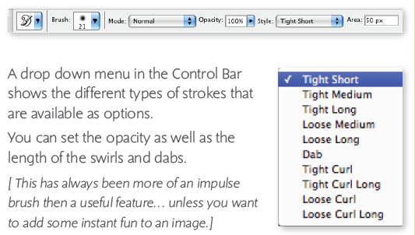


Slide 17
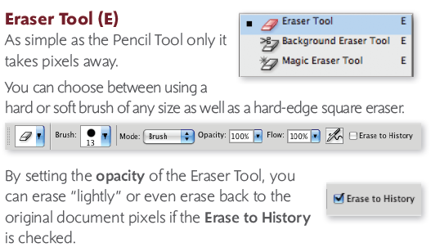
Eraser Tool(E)

Slide 18
Background Eraser Tool(E)
Works like a combination of the Quick Selection Tool and the Eraser.
Using the Brush, you click on the color you want to erase and it will begin erasing. If the image is flat it will convert it into a layer and a transparent background will appear.

Slide 19
Magic Eraser Tool(E)
Works like a combination of the Magic Wand Tool and the Eraser.
Using the Brush, you click on the color you want to erase and it disappears. Just like magic!
  Tolerance is the setting to choose how much (high number) or how little (low number) of similar pixels will be erased.
  Contiguous is the setting to choose what pixels in that tolerance will be erased. Only pixels that are touching will be selected–if Contiguous is not checked, all pixels in that tolerance will be erased even if they do not touch.

Slide 20
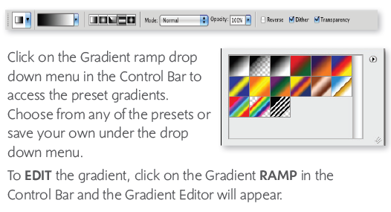
Gradient Tool(G)
The Gradient Tool is a grouped with the Paint Bucket Tool and is used for filling with simple or complex gradients.

Slide 21
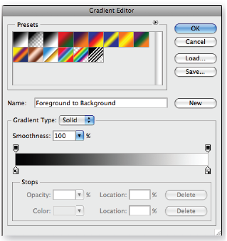

The Gradient Editor allows you to select multiple colors, place them any where on the ramp and control the opacity of the gradient overall.
Once created the gradient can be saved along with the presets.
Set the style of gradient:
  Linear, Radial, Angle, Reflected, Diamond

Slide 22
More ..
Linear Gradient
  Shades from the starting point to the ending point in a straight line.
Radial Gradient
  Shades from the starting point to the ending point in a circular pattern.
Angular Gradient
  Shades in a counterclockwise sweep around the starting point.
Reflected Gradient
  Mirrors the same linear gradient on either side of the starting point.
Diamond Gradient
  Shades from the middle to the outer corners of a diamond pattern.

Slide 23
Paint Bucket Tool(G)
Choose a color from the color picker or swatch panel, or choose from the foreground/background color drop down menu in the Control Bar.

Slide 24
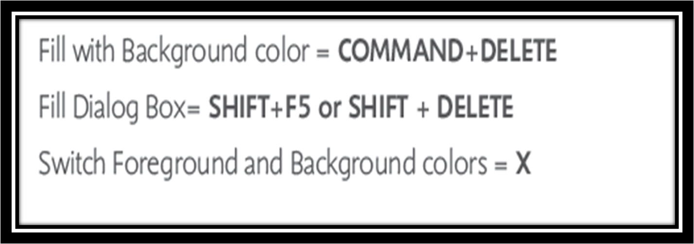
More Shortcuts …

Slide 25
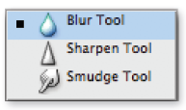

Blur Tool
The Blur tool works by blurring
the pixels much like blur filter
works, but you can control the amount and intensity with Blur Tool better than with a filter.
The Blur Tool allows you to choose a size, specify a hardness as well as a strength.
Strength is how much or how little it will blur

Slide 26
Sharpen Tool
The Sharpen tool works by applying contrast to the pixels.
It gives the appearance of sharpness, but too much sharpening reveals very bright pixels of color and results in oversharpening.
Settings for the Sharpen tool mirror those of the Blur Tool

Slide 27
Smudge Tool
The Smudge tool works like taking you finger on a chalk drawing and smudging the pixels to blend or smooth them.
Never have I used this and had them do either blend or smooth very well.
But one of the cool options is for making the Smudge tool act like Finger Painting!

Slide 28
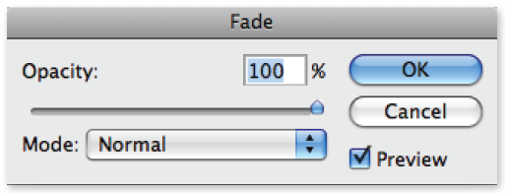
FADE! One very cool feature
When using the Brush Tools, you may perform an action that you don’t like or want to see it faded back.
Once you use a Brush, go under the Edit Menu. The last brush you used will show up under the Fade… command.

Slide 29
Toning Tools
Dodge - Lightens pixels where you paint.
Burn - Darkens pixels where you paint.
Sponge - Saturates or desaturates the pixels where you paint.

Slide 30
Dodge and Burn Tool Properties
They have a unique option for "range" with choices of highlights, midtones, and shadows.
  When set to highlights, only the lightest areas are affected.
  When set to shadows, only the darkest areas are affected.
  When set to midtones, only the middle tones are affected.
  They also have an exposure option which controls how intense the effect is. Generally you want to use both of these tools with a fairly low exposure. You will probably rarely bring it over 25%.

Slide 31
Sponge Tool Properties
Mode
  Desaturate mode dulls the colors, turning them gray.
  Saturate mode intensifies the color, making them brighter.

